Slide 1
questionnaire
2023-03-21 10:57

Slide 2
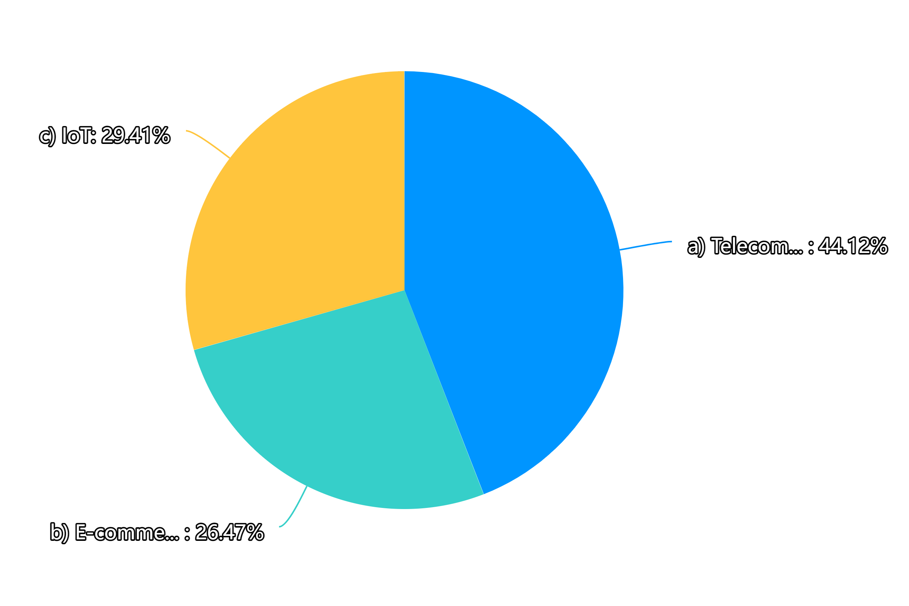
1.Your major is:

Slide 3
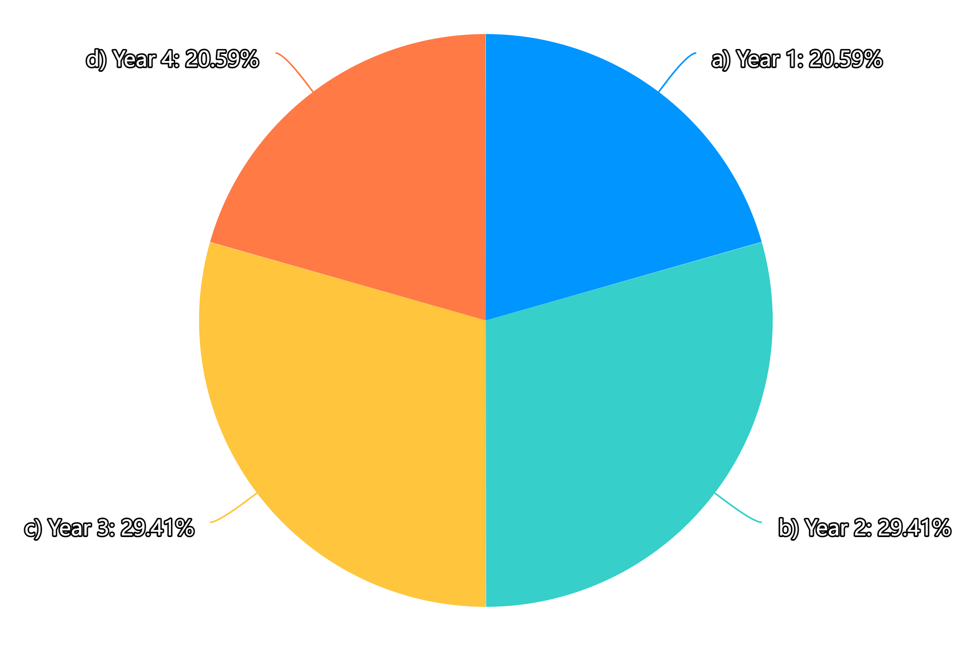
2.Your grade is:

Slide 4
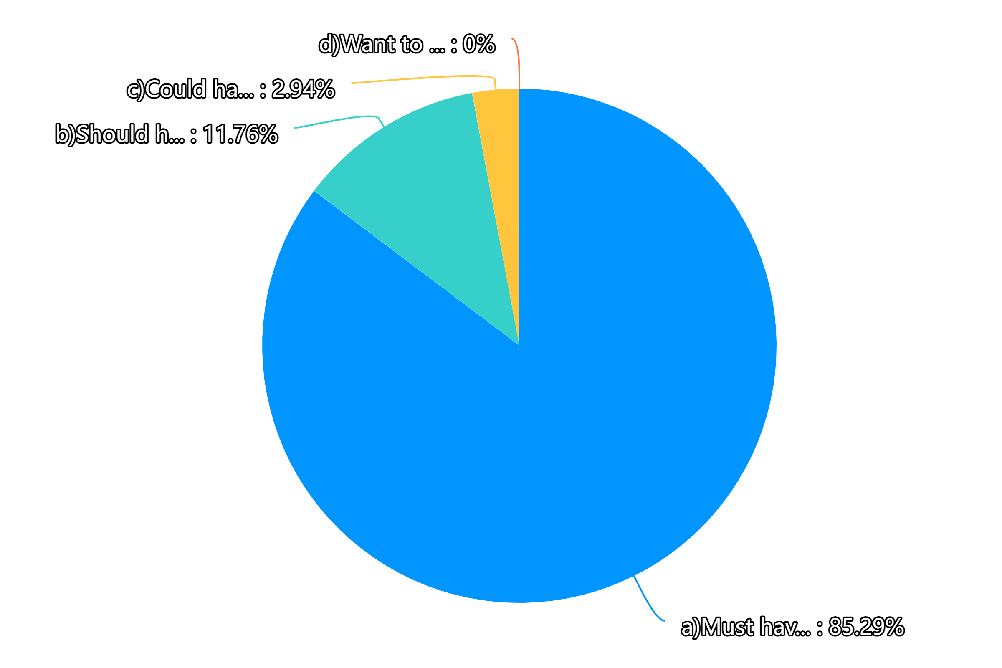
3.From your perspective, the importance of the function that you can check all your grades is:

Slide 5
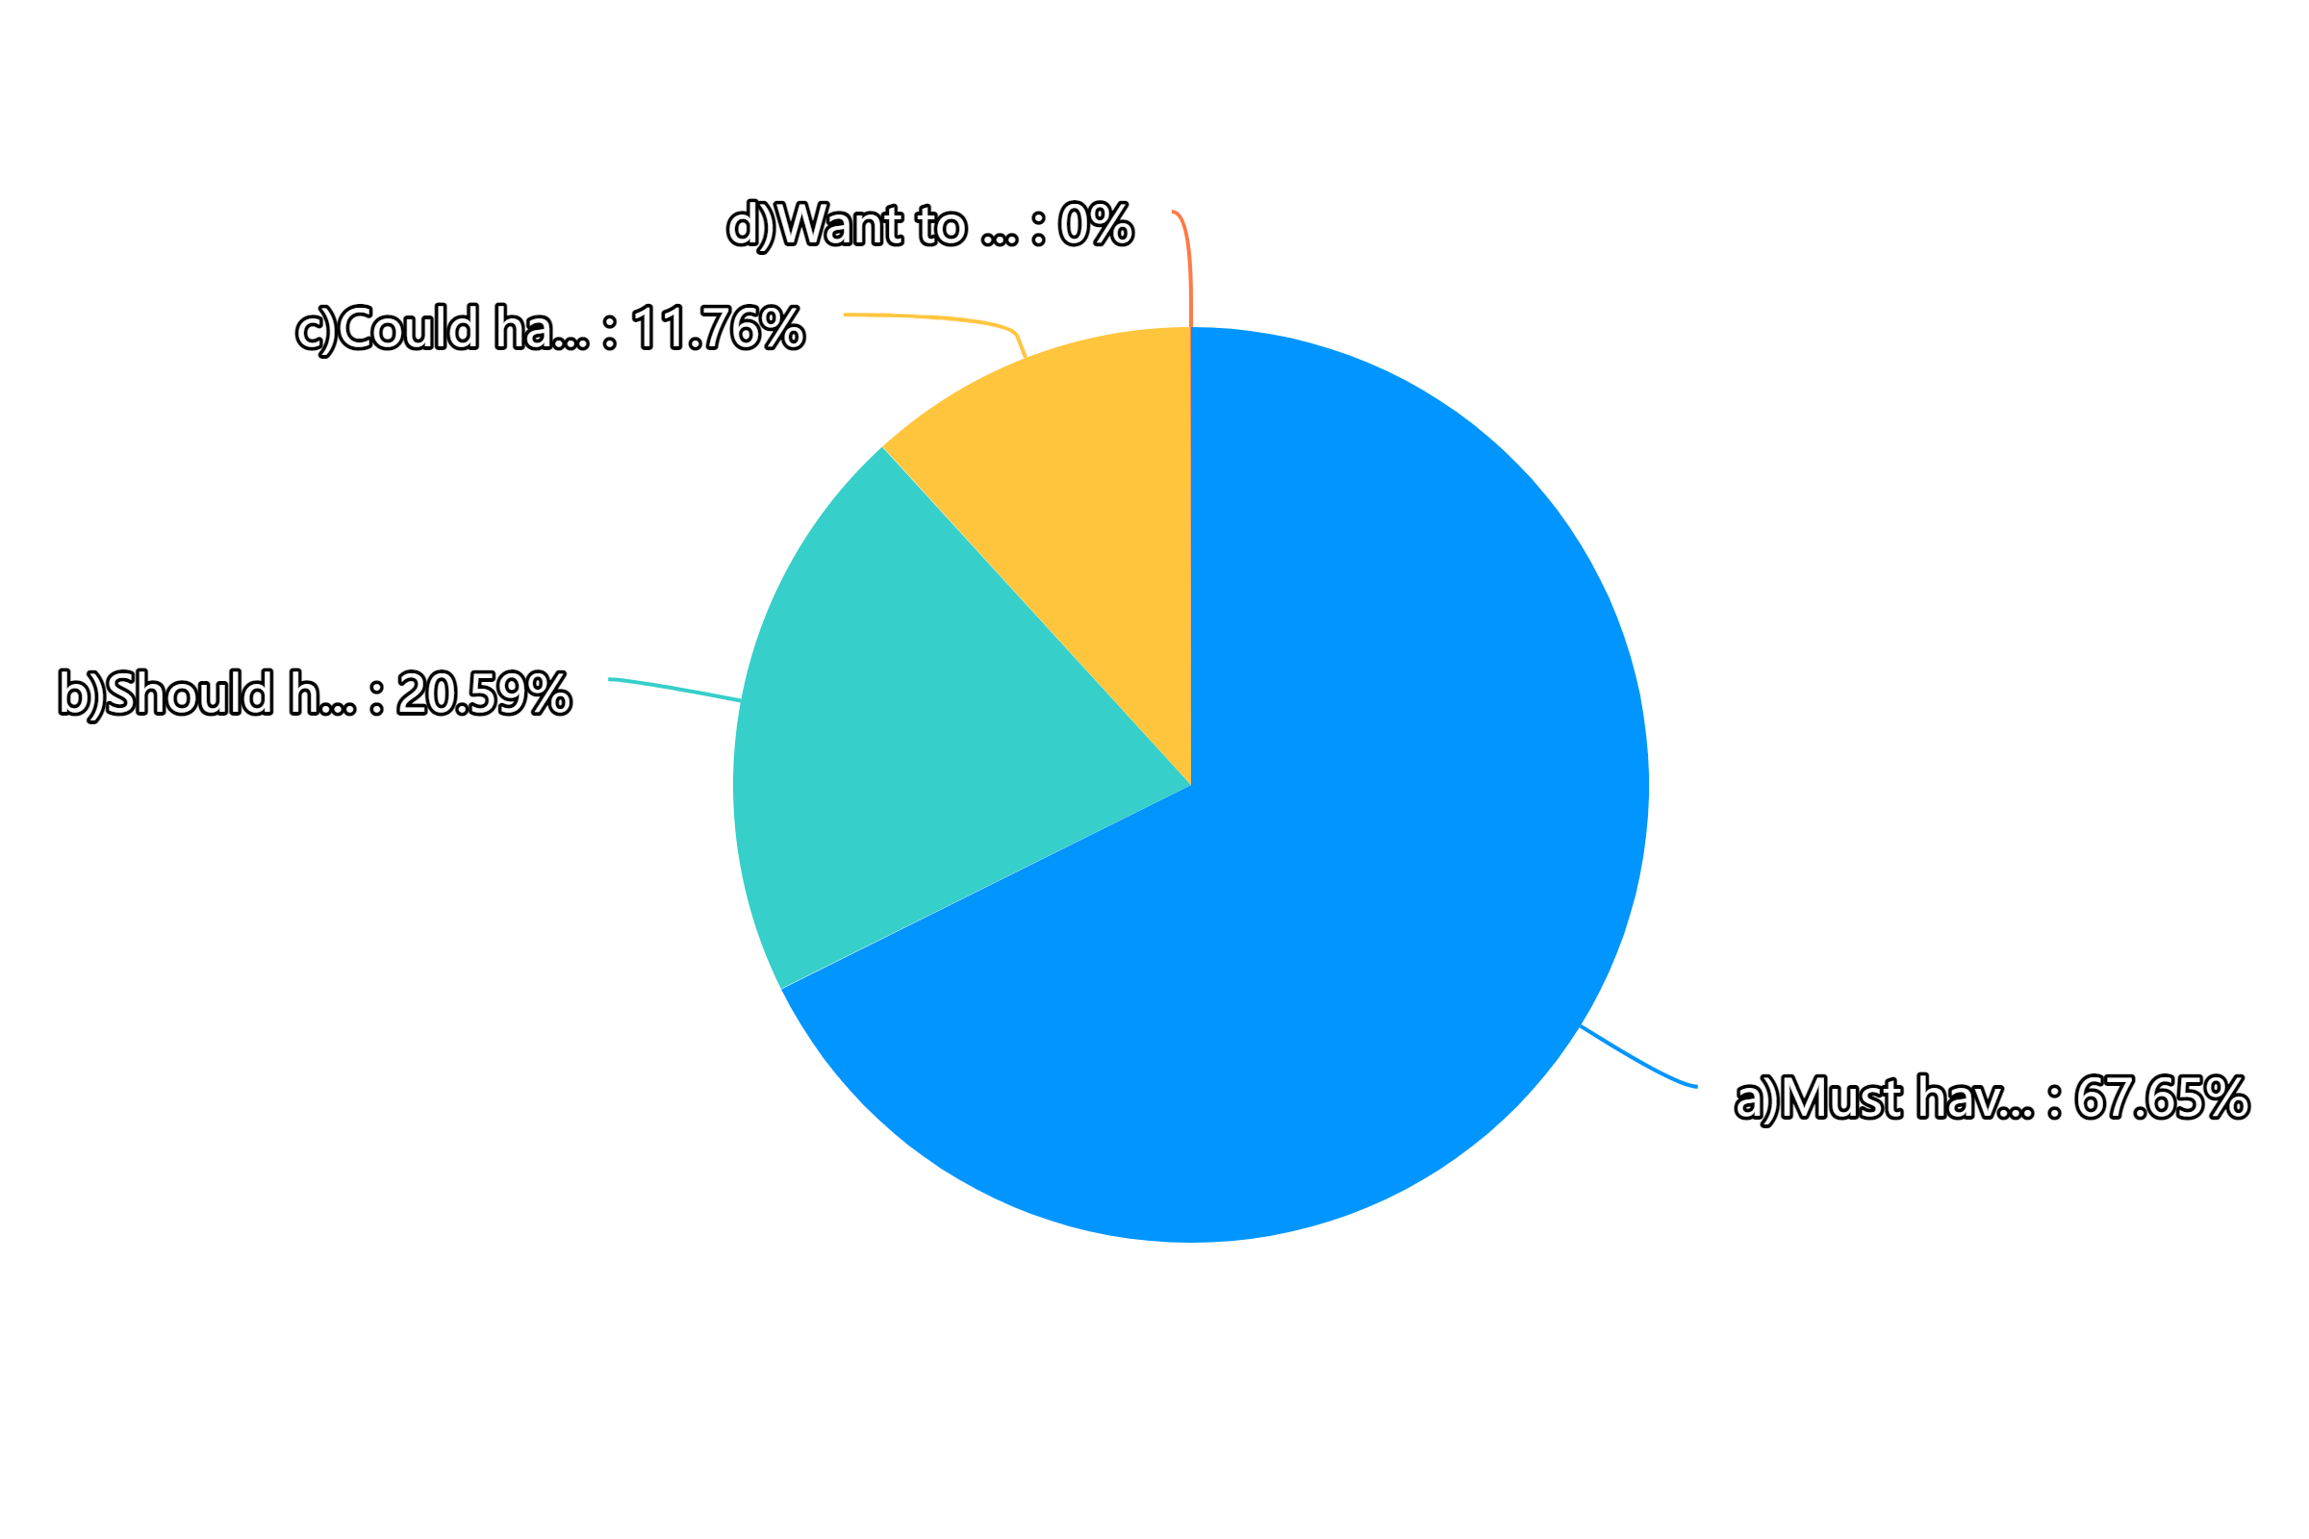
4.From your perspective, the importance of the function that you can export and print a transcript with all the subjects is:

Slide 6
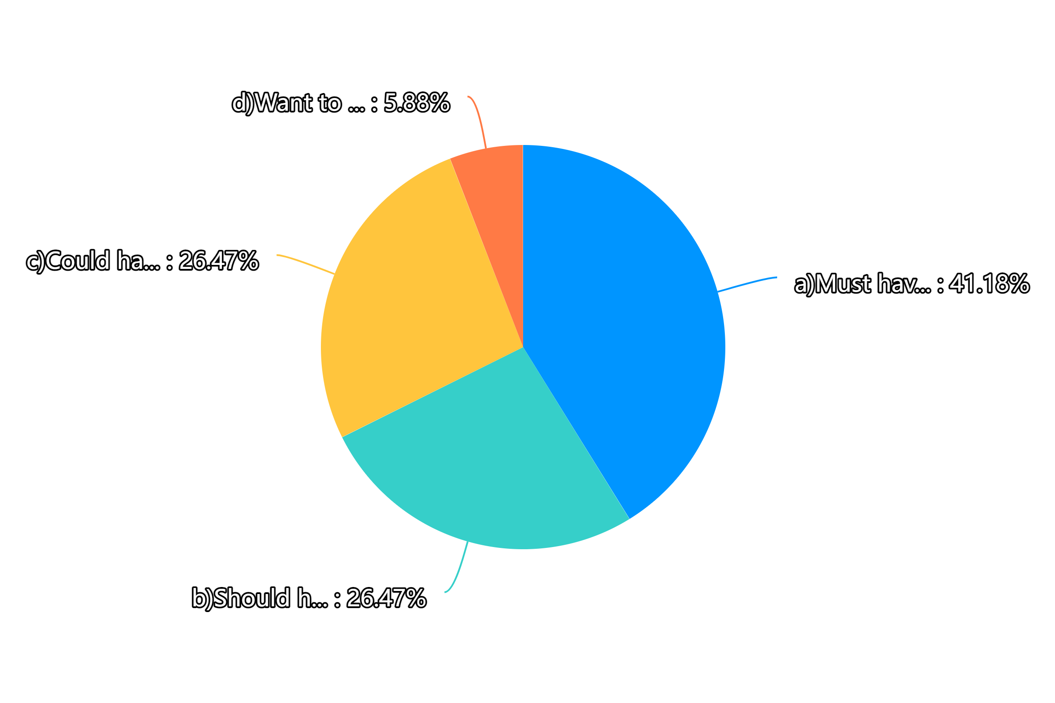
5.From your perspective, the importance of the function that you can check the details of curriculums including the profiles and materials of teachers is:

Slide 7
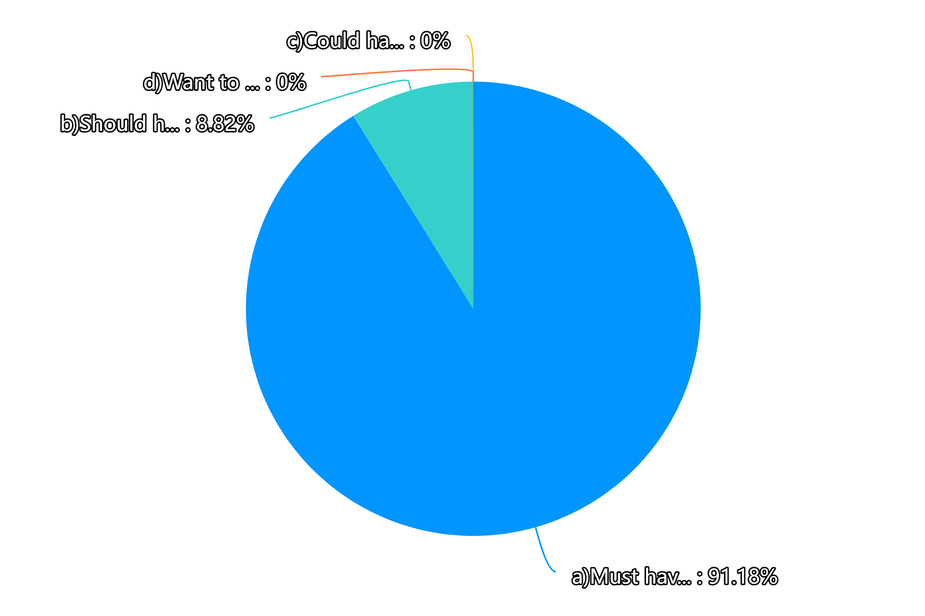
6.From your perspective, the importance of the function that you can check GPA, ranks and your average scores is:

Slide 8
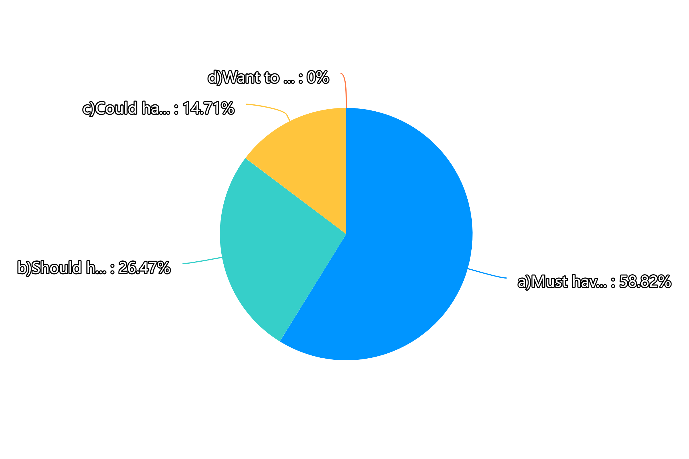
7.From your perspective, the importance of the function that you can check the class schedule is:

Slide 9
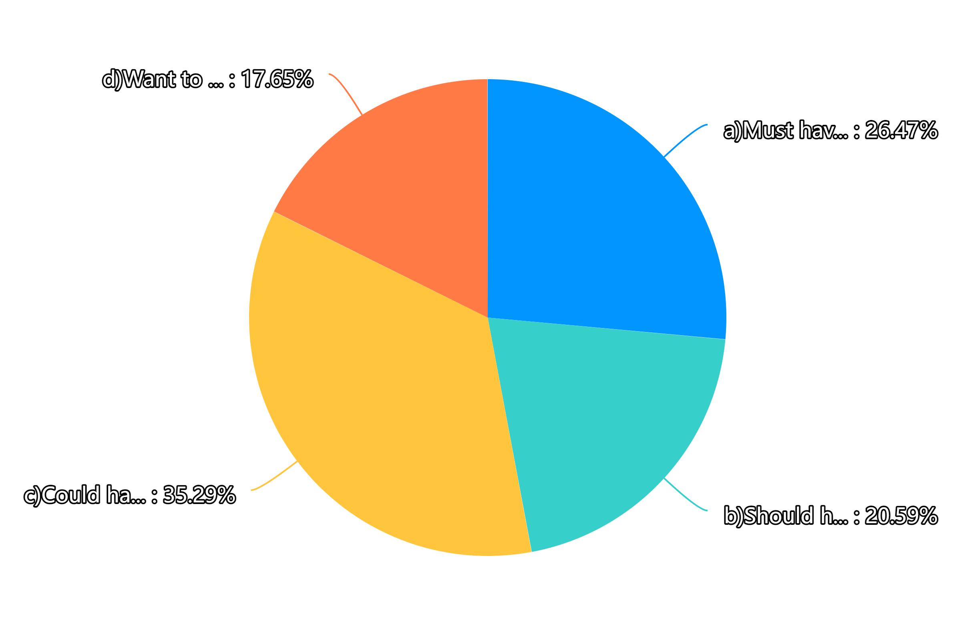
8.From your perspective, the importance of the function that you can learn how subjects relate to each other and how important they are for the further study is:

Slide 10
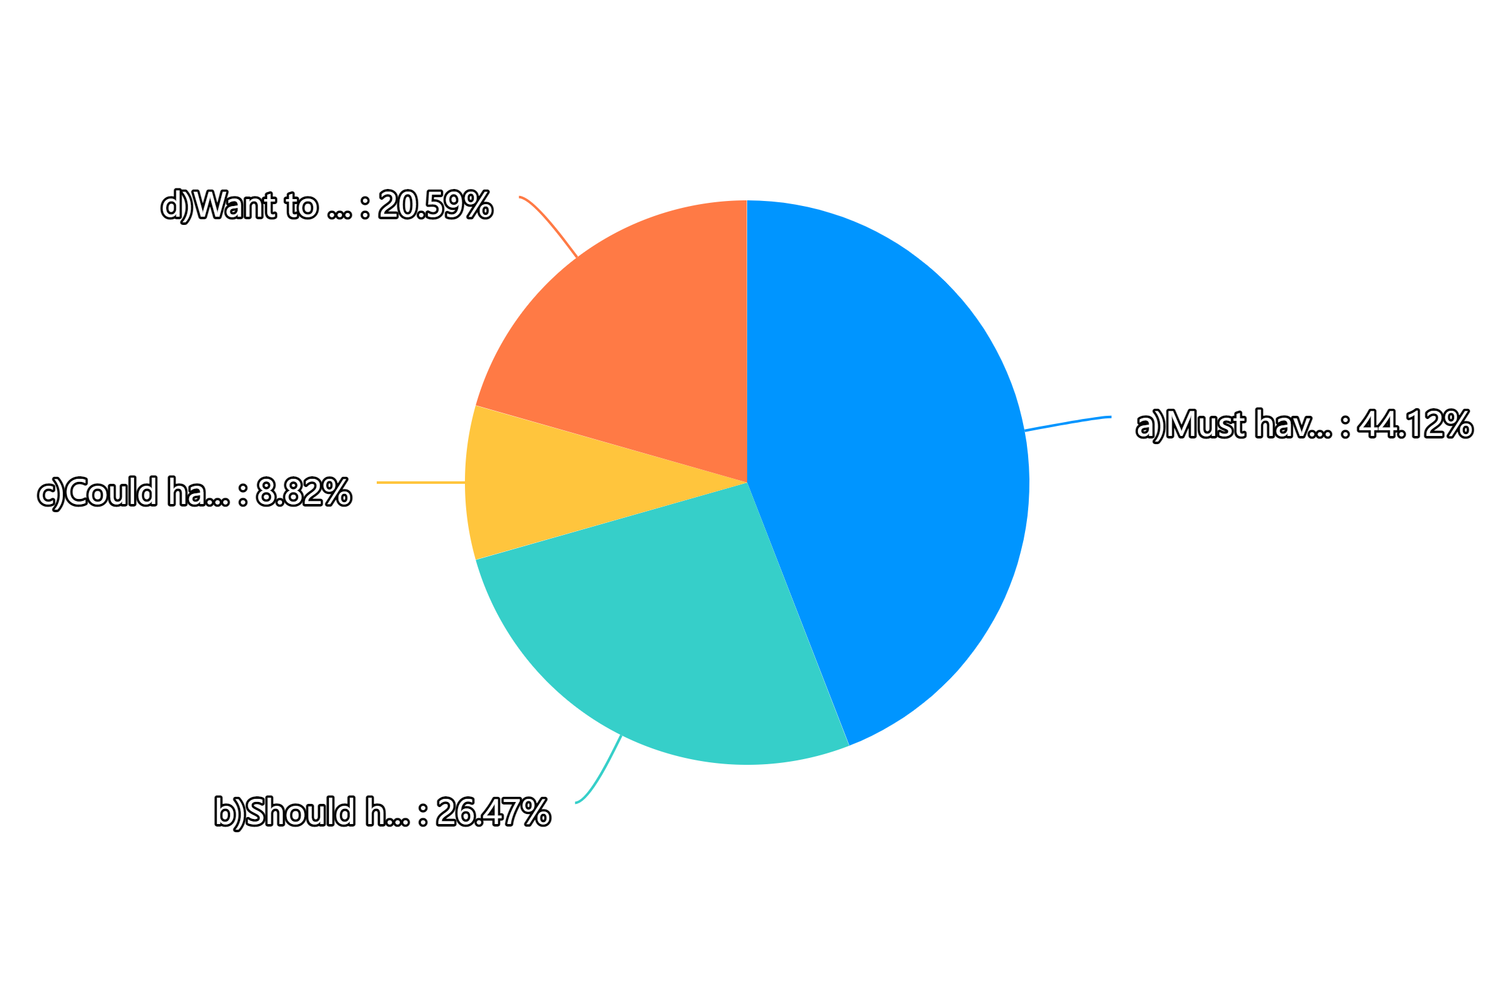
9.From your perspective, the importance of the function that you can query your CET-4, CET-6, and other award certificates is:

Slide 11
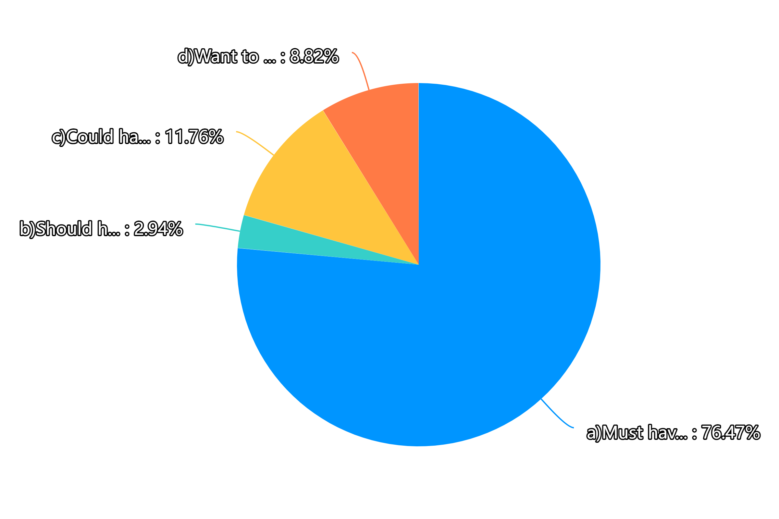
10.From your perspective, the importance of the function that you can register the system with a student number, ID card, and a self-created password with specific requirements is:

Slide 12
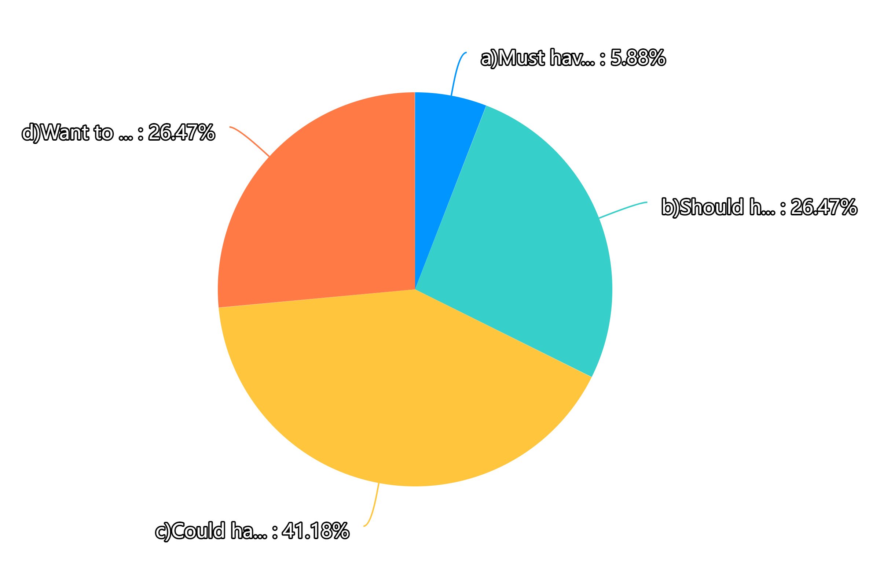
11.From your perspective, the importance of the function that you can enjoy a simple but effective UI design is:

Slide 13
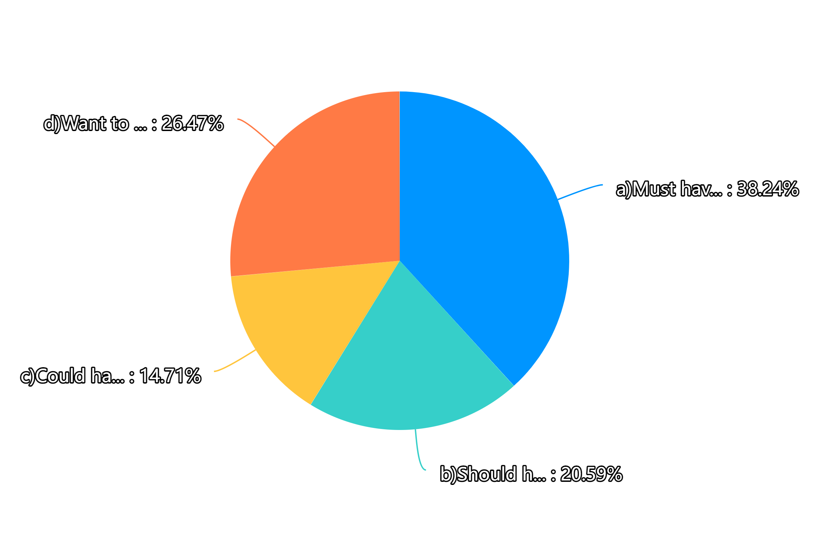
12.From your perspective, the importance of the function that you can enjoy a stable system is:

Slide 14
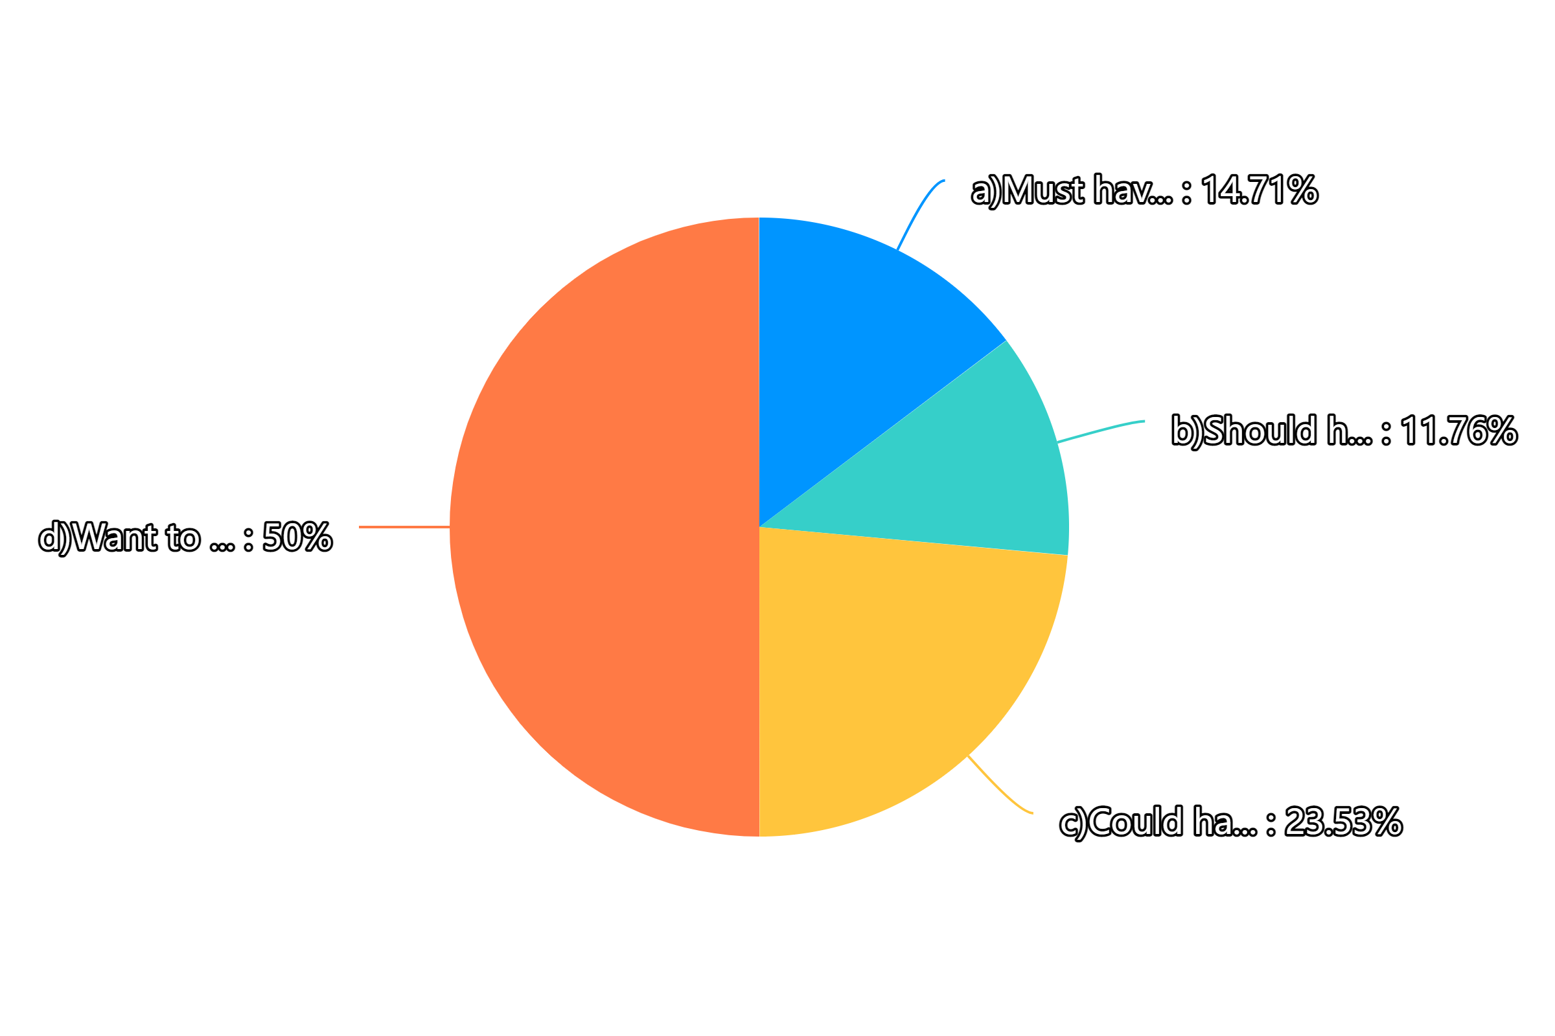
13.From your perspective, the importance of the function that you can click the help button when you need to report and problems is:

Slide 15
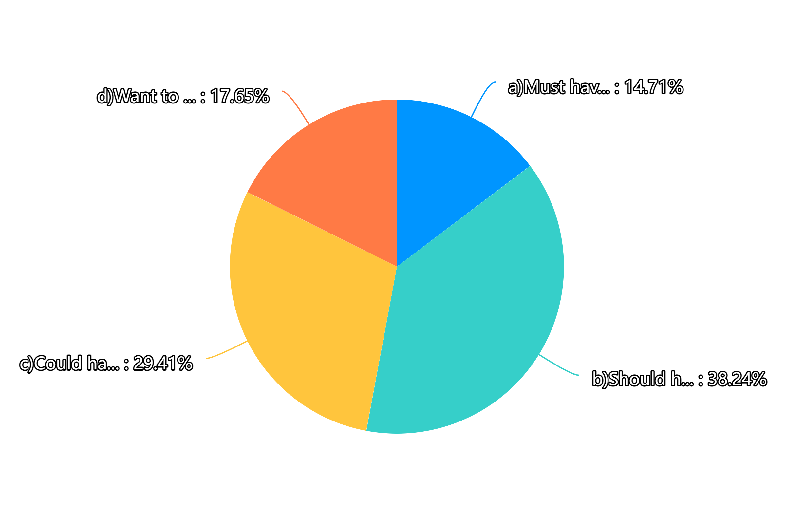
14.From your perspective, the importance of the function that you can indicate courses taken, courses being taken, and future courses based on my grade is:

